Slide 1
OBJECT ORIENTED PROGRAMMING WITH C++

Slide 2
Faculty Details
Name : Mamatha Balachandra
Designation : Asst. Professor Sr. scale
Department : Computer Science & Engg.
Cabin No. : 15
Location : AB-5
Mobile No. : 9901724673
Email-Id : mamtha.bc@manipal.edu
Computer Science and Engg

Slide 3
CSE 207 - OBJECT ORIENTED PROGRAMMING USING C++ (OOPS)
Course module
Introduction to C++ (4 Hrs)
Classes and objects : (6 Hrs)
Dynamic memory management (2 Hrs)
Constructors and Destructors (3 Hrs)
Inheritance (5 Hrs)
Operator overloading (10 Hrs)
Virtual functions and dynamic polymorphism (4 Hrs)
Templates (3 Hrs)
Exception handling (5 Hrs)
Stream Handling (6 Hrs)
Computer Science and Engg

Slide 4
TEXT BOOKS and REFERENCES
Text Books:
Sourav Sahay, Object oriented programming with C++, Oxford Higher Education, 2008.
References:
Stanley B Lippman, Josee Lajoe, Barbara E Moo, C++ Primer, , 4th edition 2005.
Robert Lafore, Object oriented programming in C++, Galgotia publications, 3rd edition, 2006.
Computer Science and Engg

Slide 5
Chapter 1
Introduction to C++

Slide 6
REVIEW OF STRUCTURES
To understand procedural oriented languages, we need to review structure concept
Need for Structures – value of 1 variable depends on the value of another variable.
Eg- Date can be programmatically represented in C by 3 different int variables.
Say int d,m,y; d-date, m-month, y-year

Slide 7
Although 3 variables are not grouped in a code, they actually belong to the same group. The value of 1 may influence the value of other.
Consider a function nextday( ) that accepts the addresses of 3 integers that represent a date and changes these values to represent nextday

Slide 8
Prototype of this function
//for calculating the next day void nextday(int *,int *, int *);
Suppose
d=1;
m=1;
y=2002; //1st january 2002
If we call nextday( &d, &m, &y);
d becomes 2, m=1,y=2002

Slide 9
But if d=28; m=2; y=1999;//28th Feb 1999
and we call the function as
nextday( &d, &m, &y);
d becomes 1, m will become 3 and y will become 1999.

Slide 10
Again if d=31; m=12; y=1999;//31th Dec 1999
and we call the function as
nextday( &d, &m, &y);
d will become 1 , m will become 1 and y
becomes 2000.
A change in 1 variable may change the value of other 2.
No language construct exist that actually places them in same group.

Slide 11
Members of wrong group may be accidentally sent to the function
d1=28; m1=2; y1=1999; //28thfeb99
d2=19; m2=3; y2=1999; //19thmrch99
nextday(&d1,&m1,&y1); //ok
nextday(&d1,&m2,&y2); //incorrect set passed
Above listing show problems in passing groups of programmatically independent but logically dependent variables

Slide 12
There is nothing in language itself that prevents the wrong set of variables from being sent to the function. Suppose nextday() accepts an array as parameter,
Then its prototype will be
void nextday(int *);
Let us declare date as an array of 3 integers.
int date[3];
date[0]=28;
date[1]=2;
date[2]=1999; //28th Feb 1999

Slide 13
Let us call the function as follows nextday(date);
The values of date[0],date[1],date[2] is set to 1,3 and 1999, respectively.
This method is not convincing. There is no data type of date itself.
The solution to this problem is to create a datatype called date itself using structures.

Slide 14
Struct date d1; d1.d=28; d1.m=2; //Need for structures d1.y=1999; nextday(&d1);
d1.d, d1.m, d1.y will be set correctly to 1,3,1999, since the function takes the address of an entire structure variable as parameter at a time as there is no chance of variables of different groups being sent to the function.
Structure is a programming construct in C that allows us to put the variables together

Slide 15
Library programmers use structures to create new datatypes. Application programs use these new datatypes by declaring variables of this data type
struct date d1;
They call associated functions by passing these variables / addresses to them.
d1.d=31;
d1.m=12;
d1.y=2003;
Nextday(&d1);

Slide 16
They use resultant value of the passed variable further as per requirement
printf(“The next day is: %d /%d\n”,d1.d,d1.m,d1.y);
O/P- The next day is:01/01/2004

Slide 17
Creating a New Data Type using Structures
Creation of a new datatype is a 3 step process.
Put structure definition and prototypes of associated functions in a header file.
Put the definition of associated functions in a source code and create a library.

Slide 18
3. Provide the header file and library in any media to other programmers who want to use this new data type. Creating a structure and its associated functions are 2 steps to constitute one complete process

Slide 19
Putting structure definition and prototypes of associated functions in a header file.
//date.h contains structure definition &
// prototypes of associated functions
Struct date
{
int d, m, y;
}
Void nextday(struct date *);
Void getsysdate(struct date *);

Slide 20
2. put definition and other prototypes in a source code and create a library
#include “date.h”
Void nextday(struct date *p)
{//calculate date represented by *p and set it to *p}
Void getsysdate(struct date *p){ // determine //current system date & set it to *p}
//definitions of other useful & other relevant
//functions to work upon vars of date structure

Slide 21
Using Structures in Application Programs is a 3 step procedure
Include header file provided by programmer in the source code.
Declare variables of new data type in the source code
Embed calls to the associated functions by passing these variables in the source code

Slide 22
Compile the Source code to get the object file.
Link the Object file with the library provided by the library programmer to get the executable or another library.

Slide 23
Step1-Include the header file provided by the programmer in the source code
//beginning of dateuser.c
#include “date.h”
void main()
{
…
…
} //end of dateuser.c

Slide 24
2. Declare variables of new data type in the source code.
//beginning of dateuser.c
#include “date.h”
void main()
{ struct date d;
…
…
} //end of dateuser.c

Slide 25
3. Embed calls to associated functions by passing these variables in source code
//beginning of dateuser.c
#include “date.h”
void main()
{ struct date d;
d.d=28; d.m=2; d.y=1999;
nextday(&d);
…
} //end of dateuser.c

Slide 26
Procedure Oriented System has the following programming pattern -
Divides code into functions.
Data (contained in structure variables) is passed from 1 function to another to be read from or written into.
Focus is on Procedures / functions.
Procedures / functions are dissociated from data & are not a part of it. Instead receive structure variables / their addresses & work upon them

Slide 27
Drawback/Disadvantage
Data is not secure and can be manipulated by any function/procedure.
Associated functions that were designed by library programmer don’t have rights to work upon the data.
They are not a part of structure definition itself
because application program might modify the structure variables by some code inadvertently written in application program itself

Slide 28
Consider an application of around 25,000 lines in which the variables of structure is used quite extensively.
Testing may find that date being represented by one of these variables has become 29th Feb 1999.
This faulty piece of code can be anywhere in the program.
Hence Debugging will involve a visual inspection of the entire code & will not be limited to associated functions only.

Slide 29
4. While distributing his/her application, application programmer cant be sure that program would run successfully.
5. Every new piece of code accessing structure variable will have to be inspected and tested again to ensure that it doesn’t corrupt the members of structure.
6. Compilers that implement procedure oriented programming systems don’t prevent unauthorized functions from accessing / manipulating the structure variables.

Slide 30
To ensure a successful compilation of his/her code, application programmer is forced to remove those statements that access data members of structure variables.
Lack of data security of procedure oriented programs has led to Object Oriented Programming Systems

Slide 31
Object Oriented Programming Systems
Model real-world objects (RWO)
RWO has internal parts & interfaces that enable us to operate them.
Eg-LCD is RWO-has a fan and a lamp.
There are 2 switches 1 to operate fan & other to operate lamp.
Switch operation has rules.
If lamp is switched on, fan is automatically switched on, else lcd will be damaged.

Slide 32
Lamp is also switched off if fan is switched off and switches are linked with each other.
Common Characteristic of RWO-
If a perfect interface is required to work on an object , it will have exclusive rights to do so.
Coming to C++, observed behaviour of LCD projector resembles the desired behaviour of the date’s structure variables.

Slide 33
Compilers implementing OOPs enable data security enforcing a prohibition by throwing compile-time errors against the pieces of code.
RWO ensure a guaranteed initialization of objects
OOPS Features –
Inheritance
Polymorphism

Slide 34
Inheritance allows one structure to inherit the Characteristics of other structure.
variable of new structure will contain data
members mentioned in new structure definition.
Due to inheritance, it will also contain data
members in existing definition from which new
structure has inherited.

Slide 35
In Inheritance, both data and functions may be inherited
Parent class can be given the general characteristics, while its child may be given more specific characteristics.
Inheritance allows code reusability by keeping code in a common place – the base structure.
Inheritance allows code extensibility by allowing creation of new structures that are suited to our requirements compared to existing structures.

Slide 36
Inheritance – a process by which 1 object can acquire the properties of another object.
This is important as it supports classification
Most knowledge is made of hierarchical Classification.
Eg-Red delicious apple is part of apple classification which in turn is a part of fruit class, which is under the larger class food.
Inheritance mechanism makes it possible for one object to be a specific instance of a more general class.

Slide 37
Polymorphism
Using operators or functions in different ways
depending on what they are operating on is called Polymorphism
Static & Dynamic Polymorphism
Functionoverloading & OperatorOverloading

Slide 38
C | C++
1. C compiler cannot execute C++ programs 2. In C, u may / may not include function prototypes | 1. C++ compiler can execute C programs 2. In C++, you must Include function prototypes
3. C doesn’t allow for default arguments | 3. C++ lets you to specify default arguments in function prototype
4. Declaration of the variables must be at the beginning | 4. Declaration of the variables can be anywhere before using
5. If a C program uses a Local variable that has Same name as global variable, then C uses the value of a local variable. 6. Fun overloading is not there. 7. Function inside the structure is not allowed 8. Object initialization doesn’t exist 9. Data hiding, data abstraction and data encapsulation feature doesn’t exist | 5. In C++, u can instruct program to use value of global variable with scope resolution Eg- cout << “Iamglobal var :” << ::I; 6. Fun overloading exists 7. Function inside the structure is allowed 8. Object initialization (constructor) exist 9. Data hiding, data abstraction and data encapsulation exists in C++

Slide 39
Console input-output in C++
Console output
cout << constant/variable
cout<<endl;
cout<<“\n”;\\newline
2. Console input
cin>> variable

Slide 40
Variables in C++
Can be declared anywhere in the C++ program before using them.

Slide 41
Reference variable
  are used as aliases for other variables within a function.
    All operations supposedly performed on the alias (i.e., the reference) are actually performed on the original variable.
    An alias is simply another name for the original variable.
    Must be initialized at the time of declaration.
  Example
    int count = 1;
    int &cRef = count;
    cRef++;
      Increments count through alias cRef

Slide 42
Reference variable
  #include <iostream.h>
  void main()
  {
  int x=3;
  int &y=x;
  cout <<“x=“<<x endl<<“y=“<<y<<endl;
  y=7;
  cout <<“x=“<<x <<endl<<“y=“<<y<<endl;
  }
  x=3
  y=3
  x=7
  Y=7
Creating a reference as an alias to another variable in the function
Assign 7 to x through alias y

Slide 43
Reference variable
  The value of a reference variable can be read in the same way as the value of an ordinary variable is read. Consider the following:
  #include <iostream.h>
  void main()
  {
  int x, y;
  int x=100;
  int & iRef=x;
  y=iRef;
  cout <<y<<endl;
  y++; // x and iRef unchanged
  cout <<x <<endl<<iRef<<endl<<y<<endl;
  }
  100
  100
  100
  101

Slide 44
Call by reference
Reference variable can be a function argument and thus change the value of the parameter that is passed to it in the function call.
An illustrative example follows:

Slide 45
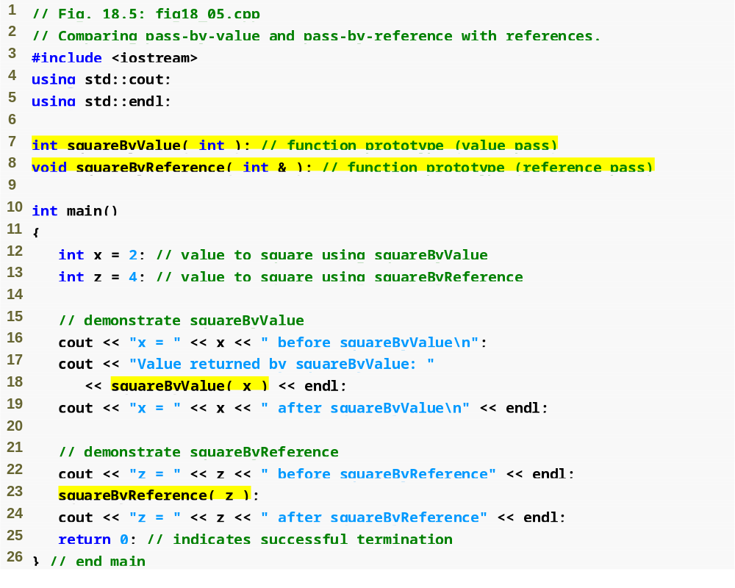
Call by Reference and Call by Value in C++
Function illustrating pass-by-value
Function illustrating pass-by-reference
Variable is simply mentioned by name in both function calls

Slide 46
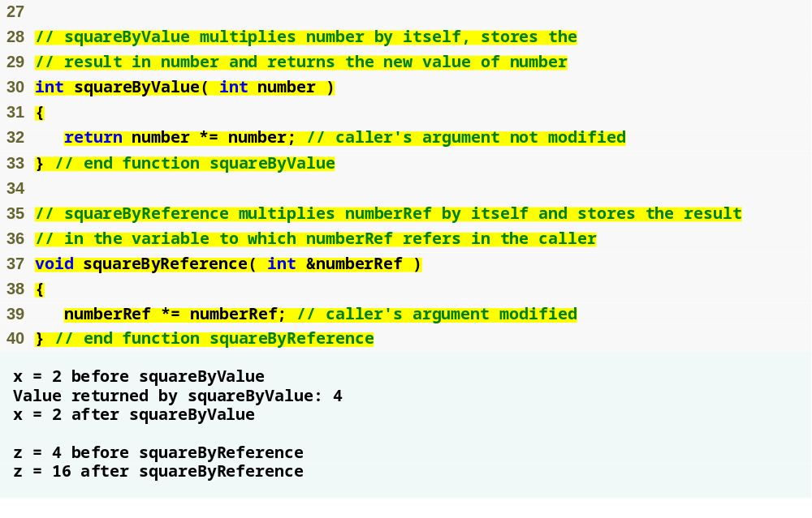
Call by Reference and Call by Value in C++
Receives copy of argument in main
Receives reference to argument in main
Modifies variable in main

Slide 47
Return by reference
Functions can return by reference also.
An illustrative example follows:

Slide 48
Reference variable
  #include <iostream.h>
  int & large (int &, int &);
  void main()
  {
  int a,b;
  a=5; b=10;
  int & r = large (a,b);
  r=-1;
  cout <<a <<endl<<b<<endl;
  }
  int & large ( int & x, int & y)
  {
  if (x>y)
  return x;
  else
  return y;
  }
  5
  -1

Slide 49
Return by reference
In the example program , variable x and a refer to the same location , while y and b refer to the same location.
From the large () function , a reference to y, that is reference to b is returned and stored in reference variable r.
The function large() does not return the value y because the return type is int & and not int.
Thus the address of r becomes equals to the address of b. So, any change in value of r also changes the value of b

Slide 50
Return by reference
The previous program can be shortened as:
  #include <iostream.h>
  int & large (int &, int &);
  void main()
  {
  int a,b;
  a=5; b=10;
  large (a,b)=-1;
  cout <<a <<endl<<b<<endl;
  }
  Output
  5
  -1
A function that returns by reference, primarily returns the address of the returned variable

Slide 51
Assignment (=) operator with various cases
If the compiler finds a non constant variable on the left side of the ‘=‘ operator , it does the following actions:
Determine the address of the variable
Transfer the control to the byte that has that address and
Write the value on the right of the ‘=‘ operator into the block that begins with the byte found above.
If a function call is found on the left side of the ‘=‘ operator , it does the following actions:
Transfer the control to the byte whose address is returned by the function
Write the value on the right of the ‘=‘ operator into the block that begins with the byte found above.
If the compiler finds a variable on the right side of the ‘=‘ operator , it does the following actions:
Determine the address of the variable
Transfer the control to the byte that has that address
Read the value from the block that begins with the byte found above
Push the read value in to the stack

Slide 52
If the call is found on right side of the ‘=‘ operator , compiles does the following actions:
Transfer the control to the byte whose address is returned by the function
Read the value from the block that begins with the byte found above
Push the read value in to the stack
A constant cannot be placed on the left of the assignment operator. This is because constants do not have a valid address.
A call to a function that returns by reference can be placed on the left side of an assignment operator.

Slide 53
Return by reference
Prof. B.R.Mohan, SSE--> www.bookspar.com | Website for students | VTU NOTES
We must avoid returning a reference to a local variable , because it can lead to run-time errors
Example:
  #include <iostream.h>
  int & abc ();
  void main()
  {
  abc() = -1;
  }
  int & abc ()
  {
  int x;
  return x;
  }
  The problem here is x will go out of scope .
  Thus the statement abd()=-1 will write -1 in an unallocated block of memory.

Slide 54
FUNCTION PROTOTYPE, FUNCTION OVERLOADING, DEFAULT ARGUMENTS AND INLINE FUNCTION

Slide 55
Function Prototyping
FP is necessary in C++.
C++ strongly supports function prototypes
Prototype describes the function’s interface to the compiler
Tells the compiler the return type of function, number , type and sequence of its formal arguments
General syntax:
return-type function-name (argument_list);
Eg: void interest (float, int, float);
Since function prototype is also a statement , a semicolon must follow it.
Providing names to the formal arguments in function prototype is optional.

Slide 56
With prototyping , compiler ensures following
The return value of a function is handled correctly.
Correct number and type of arguments are passed to a function.
What happens in the absence of prototype?
Suppose, compiler assumes that the type of the returned value is an integer. However, the called function may return a value of an incompatible type(say struct type) .
Now , suppose an int variable is equated to the call to a function where the function call proceeds the function definition . In this situation, the compiler will report an error against the function definition and not the function call
However, if the function definition is in different file to be compiled separately, then no compile time errors will arise. Instead , wrong results will arise during run-time(weird results)

Slide 57
Since C++ compiler require function prototyping, it will report error against function call because no function prototype is provided to resolve the function call.
Compiler may still give an error, if function call doesn’t match the prototype.
Hence prototyping guarantees protection from errors arising out of incorrect function calls.

Slide 58
Function Prototyping produces automatic type of conversion wherever appropriate.
For example, if the compiler expects an int type value, but a type of double value is wrongly passed. During run time, the value in first 4 bytes of the passed eight bytes is extracted. This is obviously undesirable.
However, C++ compiler converts double type to int type automatically , this this because of the function prototype before the function call.
Also, the automatic type conversion takes place only when it makes sense. For eg, struct to in is not possible.

Slide 59
Default arguments
Default values are given in the function prototype declaration.
Default arguments must be specified only in function prototypes. They should not be specified in function definitions
Whenever a call is made to a function without specifying an argument, the program will automatically assign values to the parameters.
Default values are always assigned from right to left.
For example :
  void interest (float p, int t, float r=0.25); //legal
  void interest (float p, float r=0.25, int t); //illegal
  void interest (float p, int t=10, float r=0.25); //legal

Slide 60
void sum(int, int, int=6,int=10);
void main( ) {
int a, b, c, d;
cout<<“enter any two nos.\n”;
cin >>a >>b;
sum (a,b);
}
void sum (int a1, int a2, int a3, int a4) {
int temp;
temp=a1 + a2 + a3 +a4;
cout << “sum=“ << temp;
}

Slide 61
output
enter any two nos
11 21
sum=48
If input is given for c and d, then default values will not be used.
Problem solving using C++

Slide 62
Default arguments
void DisplayStars(int = 10, int =1);
void main( )
{ DisplayStars( ); cout << endl;
DisplayStars(5); cout << endl;
DisplayStars(7,3); }
void DisplayStars(int Cols, int Rows)
{ for (int Down = 0; Down < Rows; Down++)
{ for (int Across=0; Across < Cols;Across++)
cout << ‘*’;
cout << endl; } }

Slide 63
Default arguments
void DisplayStars(int = 10, int =1);
void main( )
{ DisplayStars( ); cout << endl;
DisplayStars(5); cout << endl;
DisplayStars(7,3); }
void DisplayStars(int Cols, int Rows)
{ for (int Down = 0; Down < Rows; Down++)
{ for (int Across=0; Across < Cols;Across++)
cout << ‘*’;
cout << endl; } }

Slide 64
Default arguments
void DisplayStars(int = 10, int =1);
void main( )
{ DisplayStars( ); cout << endl;
DisplayStars(5); cout << endl;
DisplayStars(7,3); }
void DisplayStars(int Cols, int Rows)
{ for (int Down = 0; Down < Rows; Down++)
{ for (int Across=0; Across < Cols;Across++)
cout << ‘*’;
cout << endl; } }

Slide 65
Care is taken in specifying default arguments in function overloading; otherwise and ambiguity might occur.
For eg:
Int add (int, int, int =0); int add (int, int)
Can confuse the compiler.

Slide 66
Function Overloading
Overloading refers to the use of same thing for different purposes.
We can use the same function name to create functions that performs variety of different tasks, called function overloading (polymorphism).
For example a function add() can be overloaded as:
int add(int a, int b);
int add(int a, int b, int c);
float add(float a, float b);
Problem solving using C++

Slide 67
Function overloading (contd…)
A function call first matches the prototype having the same number and type of argument and then calls the appropriate function for execution.
The function selection involves the following steps:
The compiler first tries to find the exact match in which the type of actual arguments are same, and use that function
If the exact match is not found , then the compiler uses the integral promotions to the actual parameters such as:
Problem solving using C++

Slide 68
char to int
int to long or float
float to double to find a match
3. If the conversion is possible to have multiple matches then the compiler will generate an error message (ambiguous situation).
Eg:
long square(long n)
float square(float n)
A call such as: square(10)
Problem solving using C++

Slide 69
Program to compute the Area of square, rectangle and triangle
void main()
{ int area(int);
int area(int, int);
float area(float, float);
cout<<area(10)<<“\n”;
cout<<area(10,5)<<“\n”;
cout<<area(10.5, 5.5)<<“\n”;
}
int area( int s)
{ return s*s; }
int area( int a, int b)
{ return a*b;}
float area(float a, float b)
{ return (0.5*a*b); }
Problem solving using C++

Slide 70
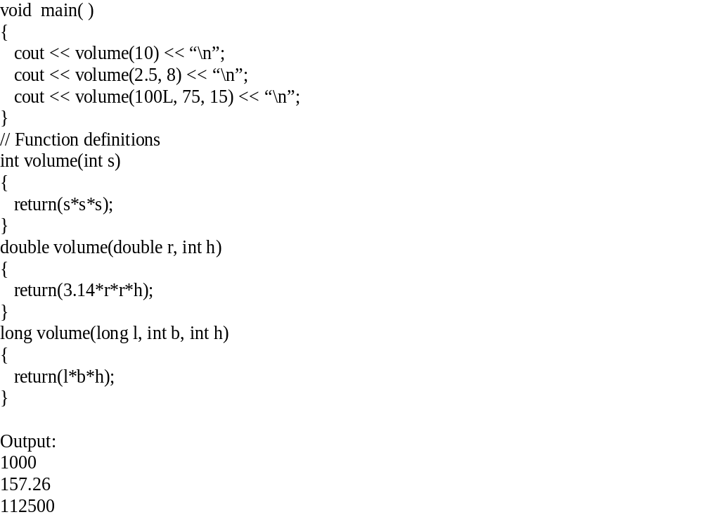

Slide 71
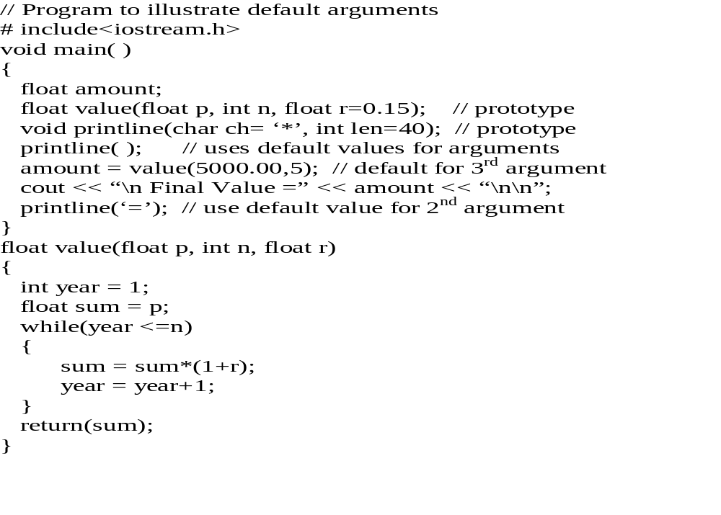

Slide 72
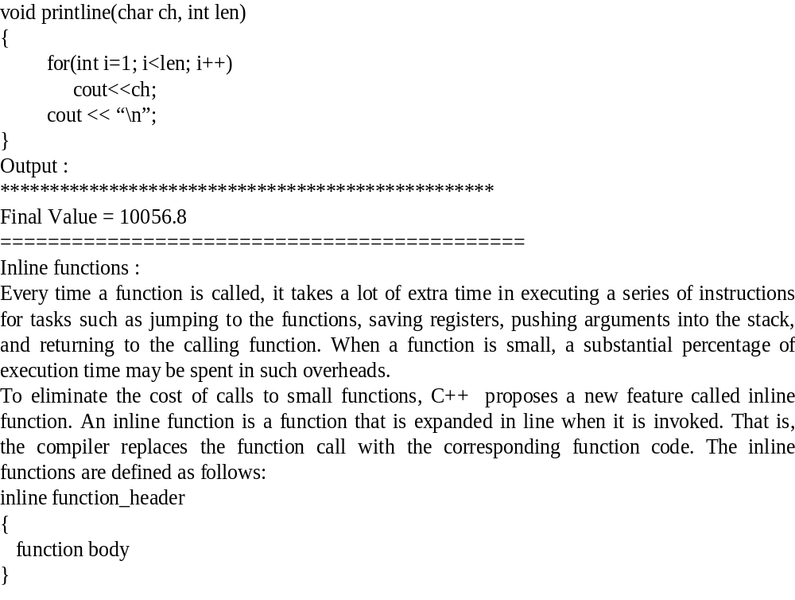

Slide 73
Macros
Dept.ofCSE
Advantage of using functions in a program:
-Saves some memory space.
-Can be called as many times as needed by the calling
function.
Disadvantage:
Every time a function is called, it takes a lot of extra time in executing a series of instructions for tasks such as jumping to function, saving registers, pushing arguments into the stack returning to calling function etc..
One solution to this problem is to use macros.

Slide 74
Dept.ofCSE
MACROS: #define statement can be used to define symbolic constants in C program. It is defined by
#define name text
Eg. #define PIE 3.1415
where name represents a symbolic name (typically in uppercase letters) and text represents the sequence of characters that is associated with the symbolic name.

Slide 75
Dept.ofCSE
Symbolic constants are replaced by their equivalent text.
During compilation process each occurrence of a symbolic constant will be replaced by its corresponding text.

Slide 76
Dept.ofCSE
#define can also be used to define macros.
i.e. single identifier that is equivalent to expressions or group of statements.
Macros resemble functions in this sense.
They are defined in an altogether different manner than functions.

Slide 77
Dept.ofCSE
#include<iostream.h>
#define area length * breadth
void main()
{
int length, breadth;
cout<< “ Length=”;
cin>>length;
cout<< “ Breadth=”;
cin>>breadth;
cout<< “Area=” << area;
}
Macros definitions are placed at the beginning of a file, ahead of the first function definition.

Slide 78
Dept.ofCSE
Multiline macros are defined by placing a backward slash(\) at the end of each line except the last line.
#include<iostream.h>
#include<stdio.h>
#define loop for (lines=1; lines<=n; lines++) { \
cout<<“*”; \
}
void main()
{
int lines,n;
cout<< “ Number of lines=”;
cin>>n;
loop
}

Slide 79
Dept.ofCSE
Differences between macro and normal functions:
Macros are sometimes used in place of functions within a program. Use of macros are in place of functions within a program eliminates the time delays associated with function calls.
If a program consists of many repeated function calls, the time savings resulting from the use of macros can become significant.

Slide 80
On the other hand, macro substitution will take place wherever a reference to a macro appears within a program.
Thus, a program that contains several references to macro may become unreasonably long.
The major drawback of macros is that they are not really functions and hence, the usual error checking does not occur during program compilation.
C++ proposes a new feature called inline function that comes out of all the problems encountered in normal functions and macros.
Dept.ofCSE

Slide 81
Ex:
#include<iostream.h>
#define AND &&
void main()
{ int marks;
cin>>marks;
if (marks < 70 AND marks>59)
cout<<“First class”;
else
cout<<“ Other than first class”;
}
Dept.ofCSE

Slide 82
Ex:
#include<iostream.h>
#define AND &&
#define CONDITION (marks < 70 AND marks>59)
void main()
{
int marks;
cin>>marks;
if (CONDITION)
cout<<“First class”;
else
cout<<“ Other than first class”;
}
Dept.ofCSE

Slide 83
Macros can have arguments just as functions:
#define AREA(x) (3.1415*x*x)
void main()
{
float rad1= 5.25,rad2=6.25,a;
a=AREA(rad1);
cout<<“The area of the circle with radius ”<<rad1
<<“ is ”<<a;
a=AREA(rad2);
cout<<“The area of the circle with radius ”<<rad2
<<“ is ”<<a;
}
Dept.ofCSE

Slide 84
Dept.ofCSE
Inline function
An inline function is a function that is expanded in line when it is invoked(or called).
i.e. the compiler replaces the function call with the corresponding function code (similar to the macros expansion).
Inline function solves the overhead involved in normal function such as:
making the control jump back and forth
Storing the address of the instruction to which the control should jump after the function terminates
In order to make the function inline, prefix the function with the keyword inline and define it before all functions that call it.

Slide 85
Dept.ofCSE
The inline functions are defined as follows:
inline function-header
{
Function body
}
The example goes like this:
inline double cube(double a)
{
return(a*a*a);
}
The above inline function can be invoked by statements like
double c=cube(3.0); //returns 27
double d=cube(2.5+1.5); // returns 64
Expression can also be the argument for inline functions.

Slide 86
Dept.ofCSE
There is a trade-off between memory and speed on using inline functions.
The inline expansion makes a program run faster because the overhead of a function call and return is eliminated.
However, it makes the program to take up more memory because the statements that define the inline function are reproduced at each point where the function is called.
Some of the situations where inline functions may not work are:
If functions are recursive
If the function contains static variables in its definition
If there is looping constructs or switch or goto exists

Slide 87
Dept.ofCSE
Example program:
#include <iostream.h>
inline float mul(float x, float y)
{
return(x*y);
}
inline double div(double p, double q)
{
return(p/q);
}

Slide 88
Dept.ofCSE
void main()
{
float a = 12.345;
float b = 9.82;
cout << mul(a,b)<<”\n”;
cout << div(a,b)<<”\n”;
getch();
}
The O/P of this program will be
121.228
1.25713

Slide 89
Differences between # define macro and inline functions:
Macros are poor predecessor to inline functions. For example, a macro for cubing a number is defined as:
# define cube(x) x*x*x
Here a mere text substitution takes place with ‘x’ being replaced by he macro parameter. For example:
A= cube(5.0); //replaced by A=5.0*5.0*5.0;
B= cube(1.5+2.5) ; // replaced by B = 1.5+2.5*1.5+2.5*1.5+2.5=11.5;
C= cube (x++); // replaced by C= x++*x++*x++
Here among 3 examples only first one works properly. An intelligent use of parenthesis solves this problem:
#define cube (x) ( (x) * (x) * (x) )
But still cube(x++) undesirably increments x thrice. But the inline cube() function , evaluates x , passes the value to be cubed, and correctly increments x once

